Slide 1
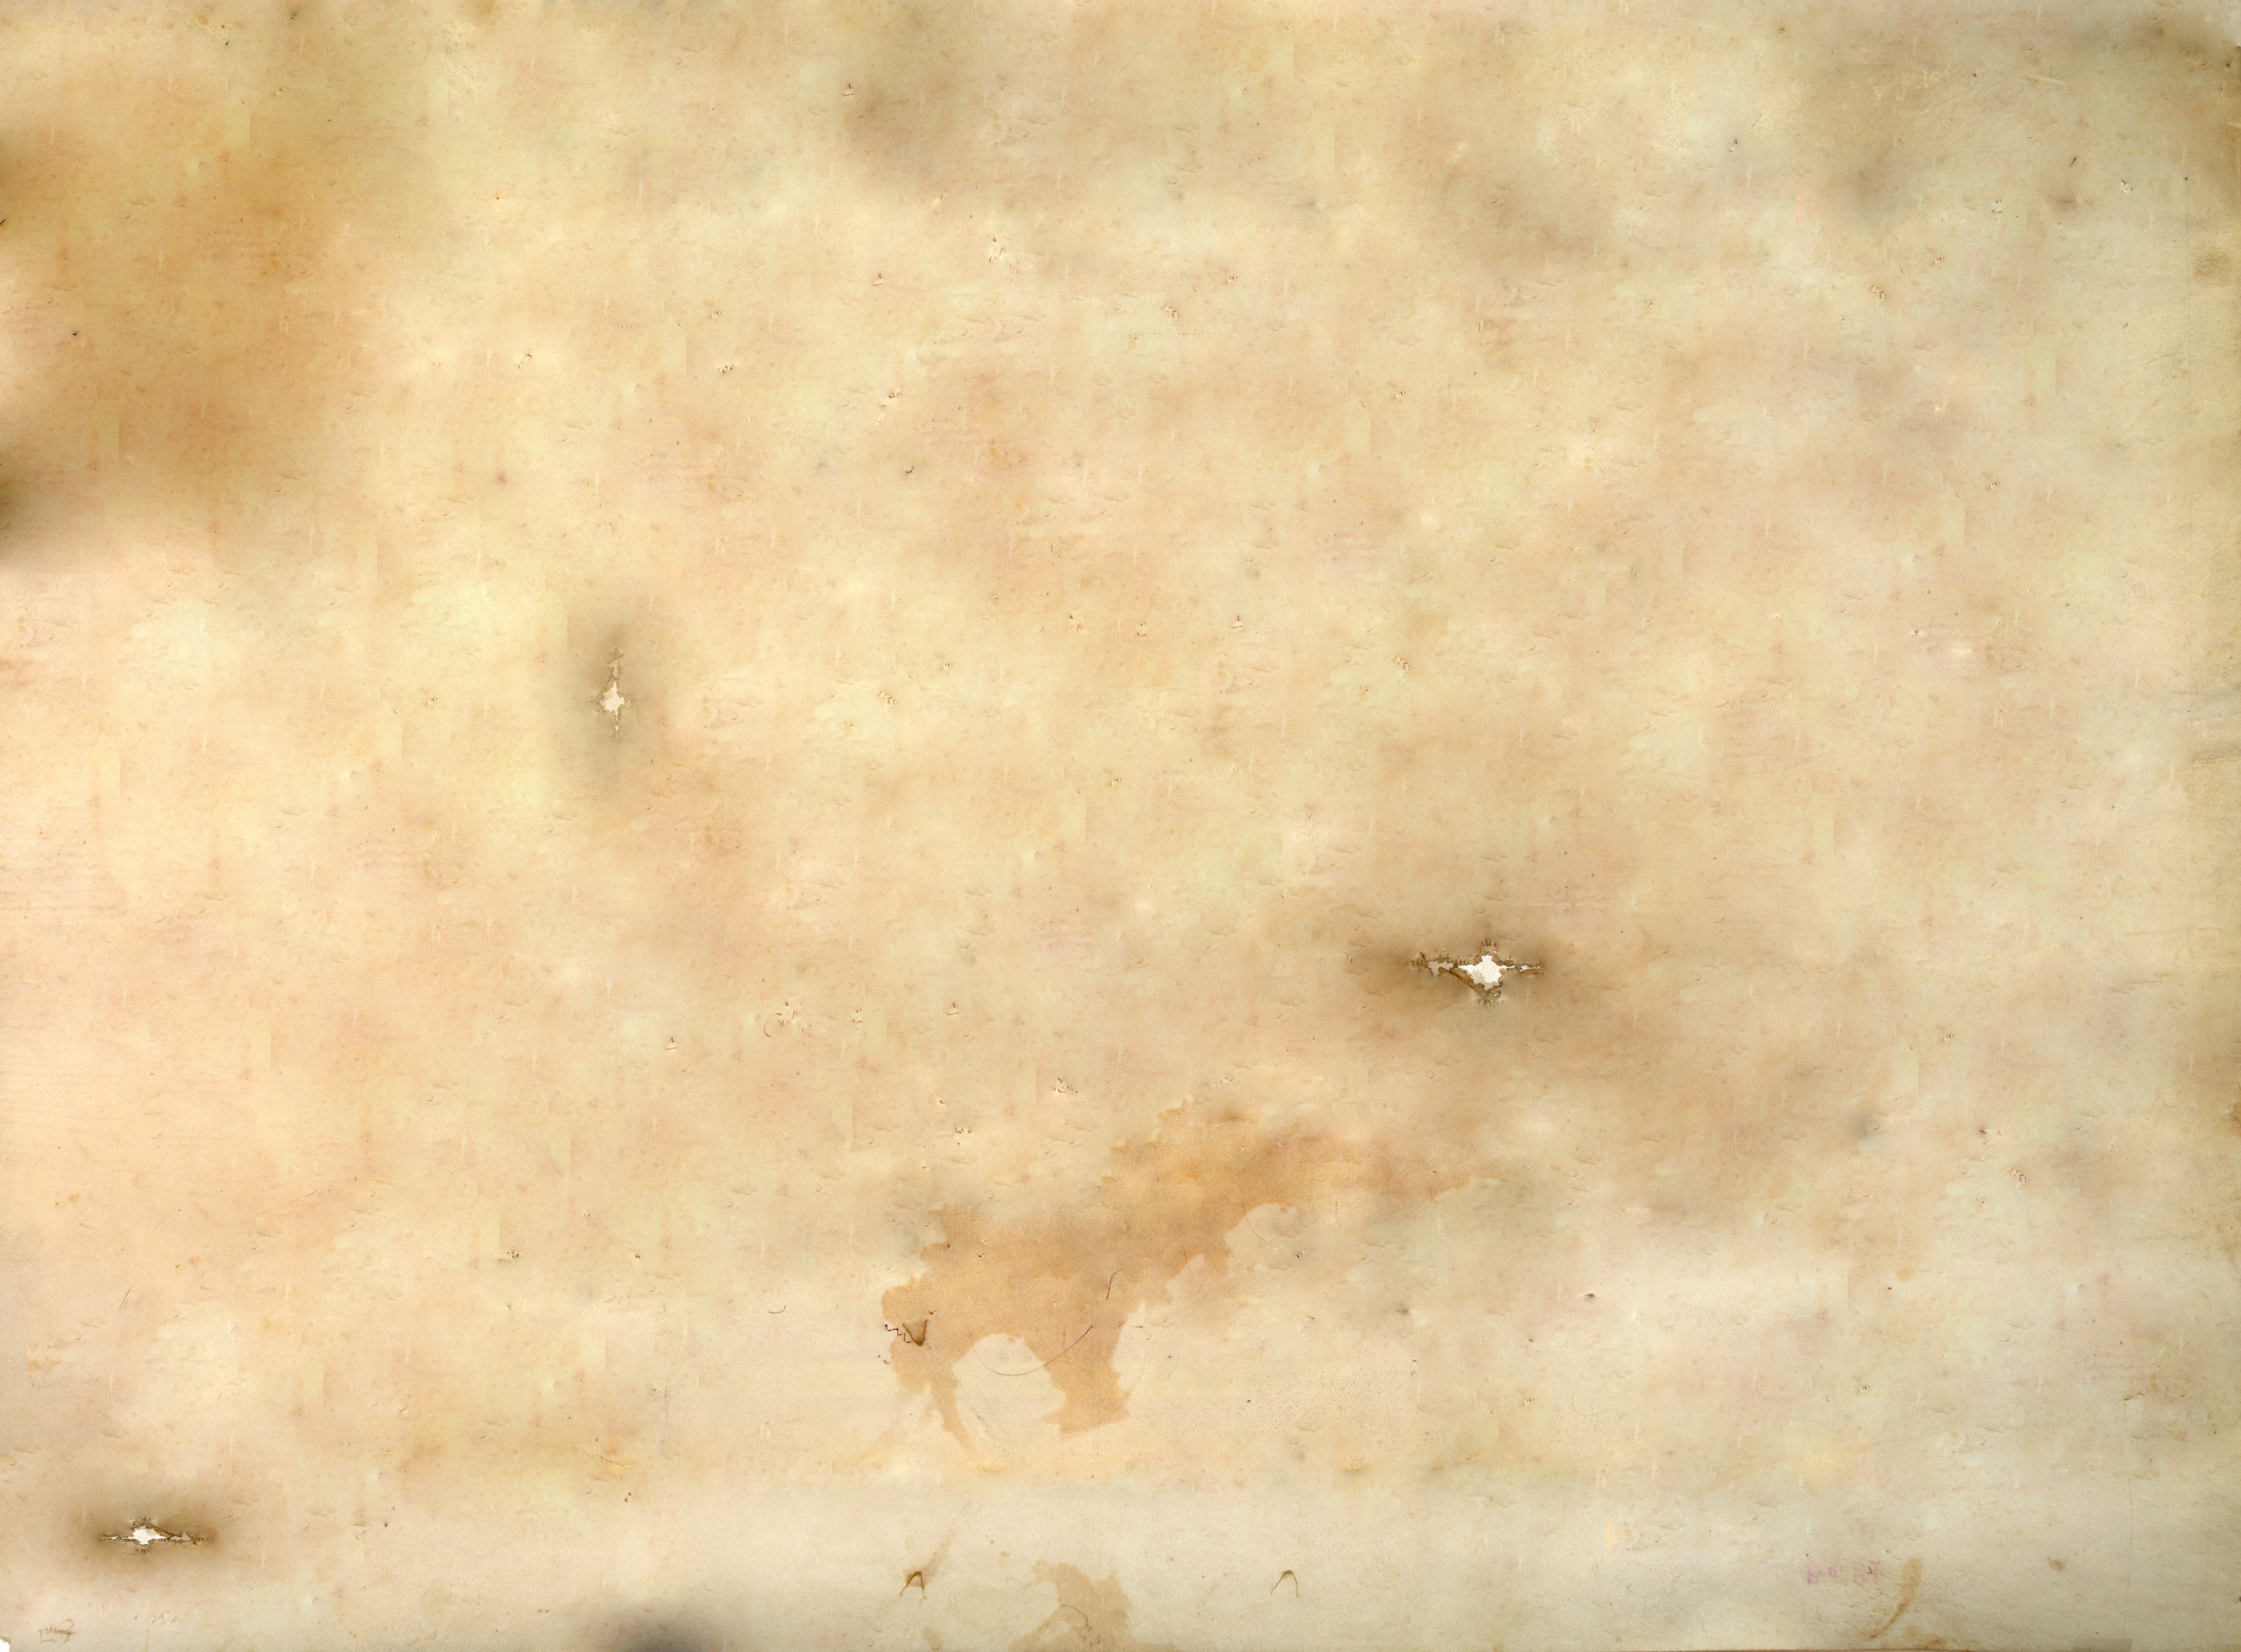
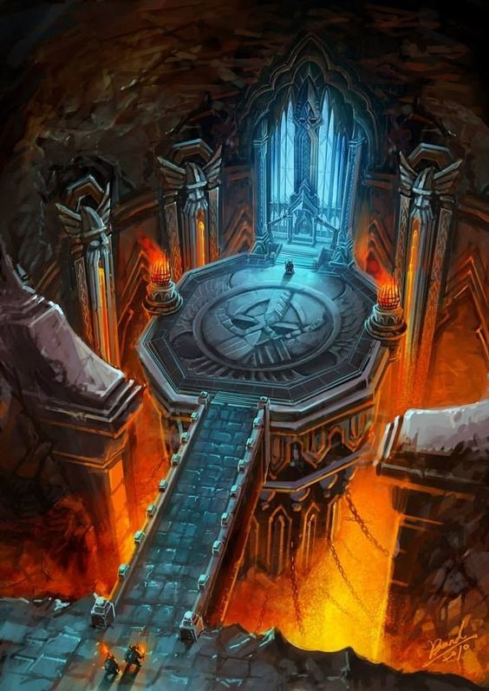
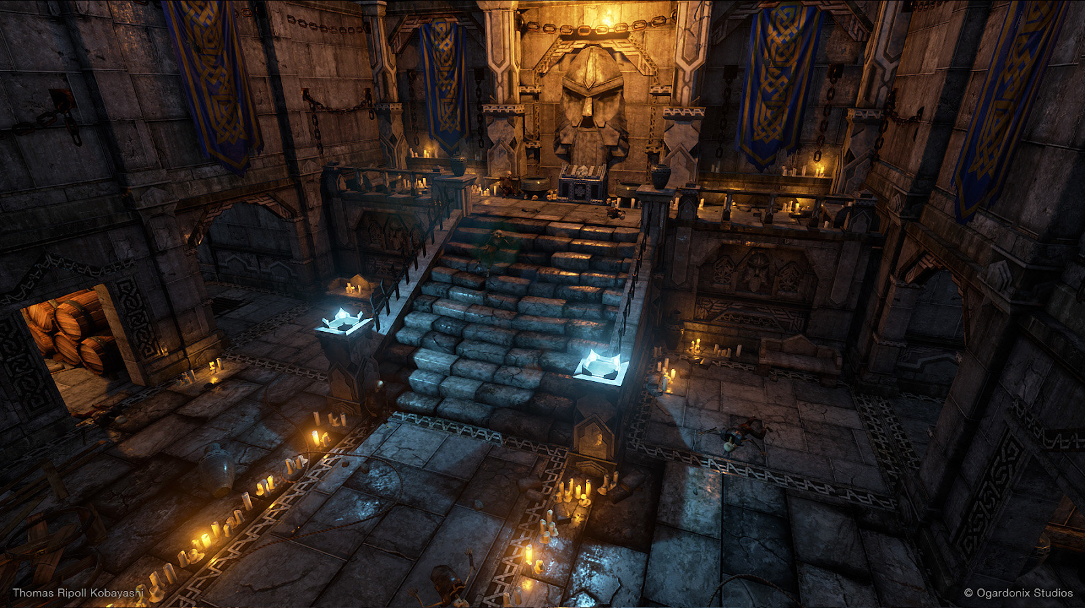
Danger Dwarves
by mijs, lajos, wouter, vera, dominik, lucas

Slide 2

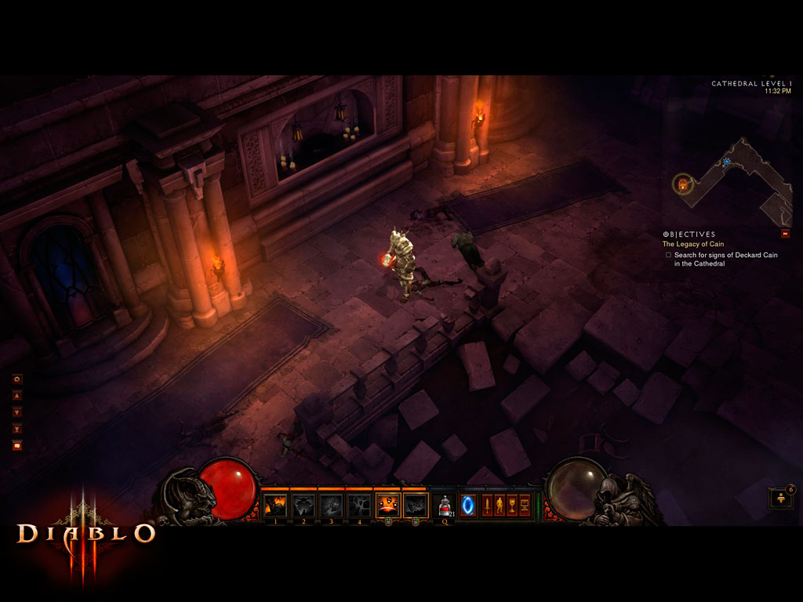
Concept
Diablo 3 / Dungeon crawler
Dwarves
Co-Op
Spiders
Dungeon

Slide 3
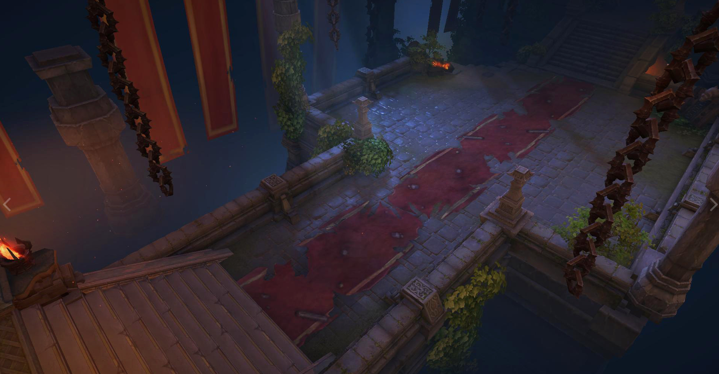
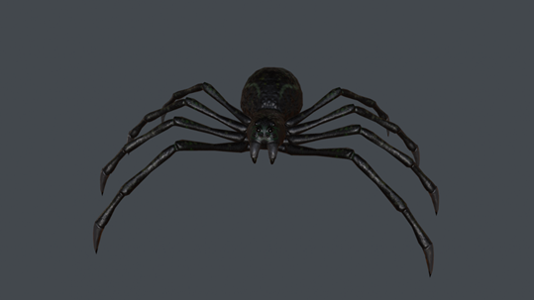
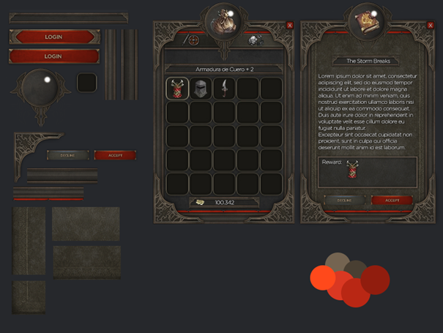
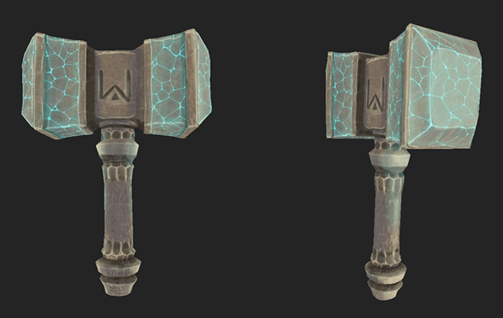
Style guide
Textures
Handpainted
Objects
Enemies
Character
UI
Weapons

Slide 4
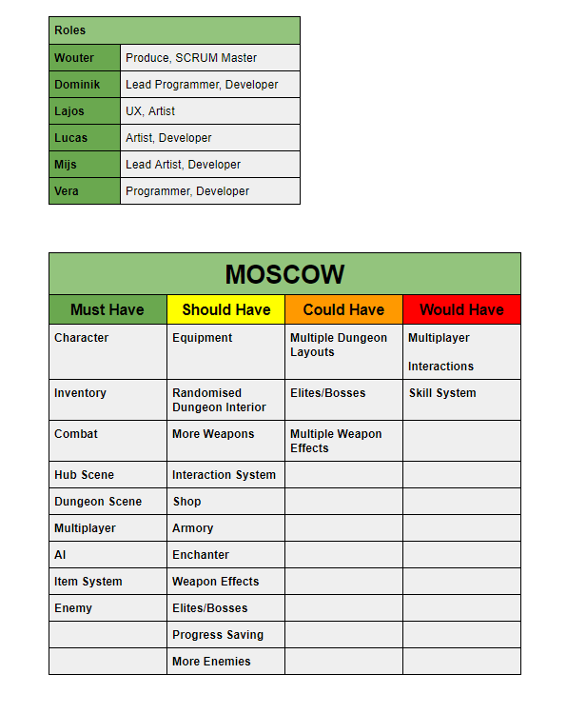
Gdd
Polycount
character max poly 6K
enemies max poly 4K
weapons max poly 2k
Environment max poly 1k
Texture resolution
character max resolution 2k target 1k
enemies max resolution 2k target 1k
weapons max resolution 1k target 512k
Environment max resolution 1k target 512k

Slide 5
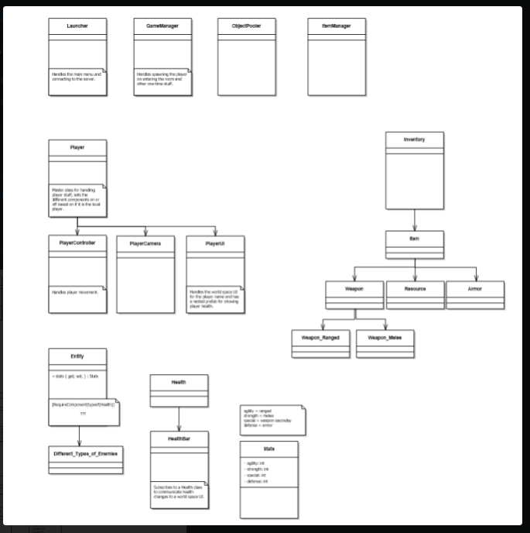
UMl

Slide 6
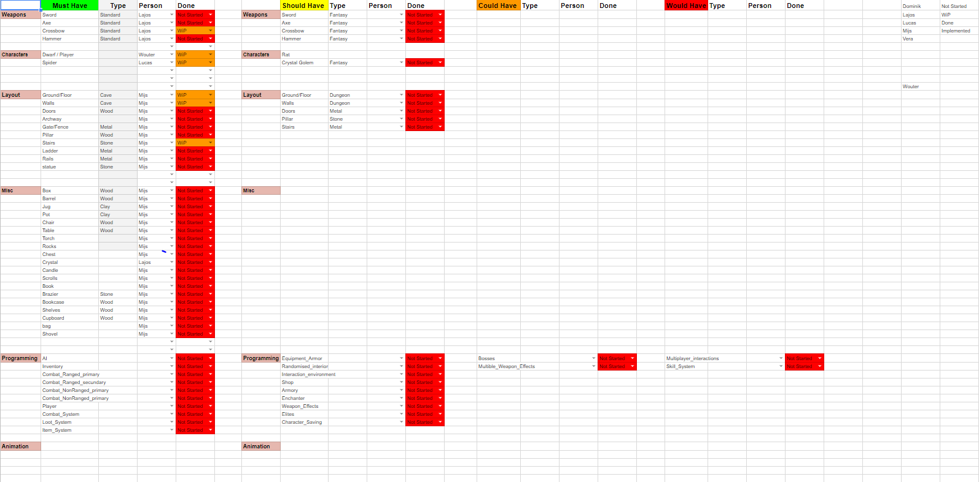
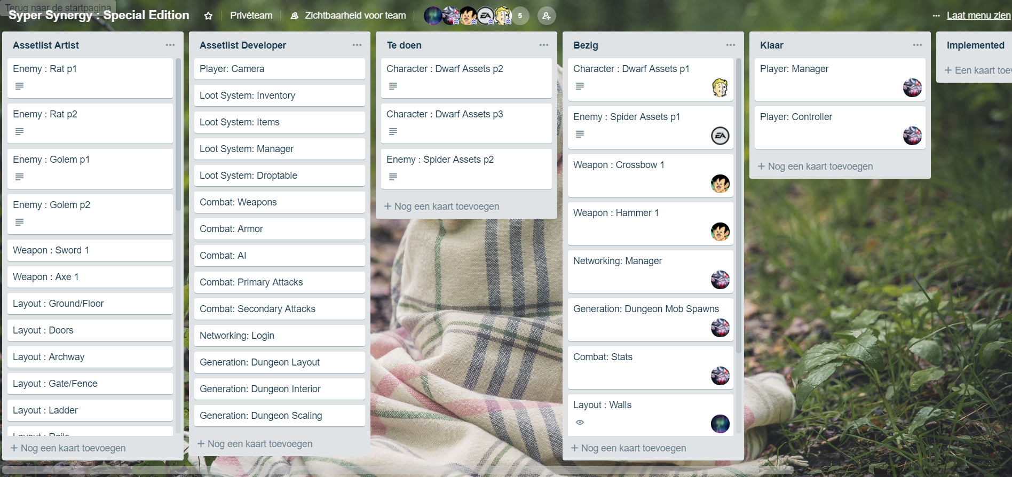
schedule and sCrum

Slide 7
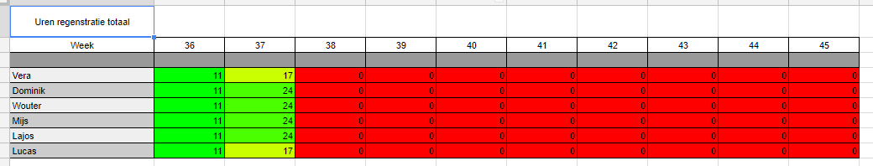
Presentie

